Slide 1

Serverless Applications

Slide 2
Overview
Serverless architectures & use cases
Serverless design patterns
Serverless concepts
AWS Lambda

Slide 3
Serverless Computing
Serverless Computing is an execution model for cloud computing environments where the cloud provider executes a piece of code (a function) by dynamically allocating resources

Slide 4
Serverless Computing vs server-based computing
In server-based computing servers have to be provisioned and run continuously to run the applications
In serverless computing, there is no need to provision the resources
servers (such as physical servers, virtual machines or containers) are still required for execution of code
a layer of abstraction is added on top of cloud infrastructure
the application developers do not need to provision and manage the underlying infrastructure required for execution of code

Slide 5
Serverless Computing
The cloud provider manages the provisioning and scaling of the infrastructure required to run the functions.
Cloud providers charge for the amount of resources used to run the code which makes serverless computing much more cost effective than server-based computing where servers have to run continuously.

Slide 6
Functions-as-a-Service (FaaS)
Serverless is also referred to as Functions-as-a-Service (FaaS).
In the serverless computing model, the code is structured into functions.
The functions are triggered by events such as an HTTP request to an API gateway, a record written to a database, a new file uploaded to cloud storage, a new message inserted into a messaging queue, a monitoring alert, and a scheduled event.
When a function is triggered by an event, the cloud provider launches a container and executes the function within the container.

Slide 7
FaaS - AWS Lambda
AWS Lambda is a popular FaaS offering from Amazon Web Services.
Lambda functions are often used to implement specific functionalities within a larger application.
Instead of running a continuous server, Lambda functions are triggered when needed, allowing for a more efficient and cost-effective use of computing resources.
This serverless approach is designed to abstract away infrastructure management tasks, enabling developers to focus on writing code and implementing business logic without concerning themselves with the underlying servers.

Slide 8
FaaS - Other serverless computing services
Azure Functions (Microsoft Azure)
Google Cloud Functions (Google Cloud Platform)
IBM Cloud Functions (IBM Cloud)
Alibaba Cloud Function Compute (Alibaba Cloud)

Slide 9
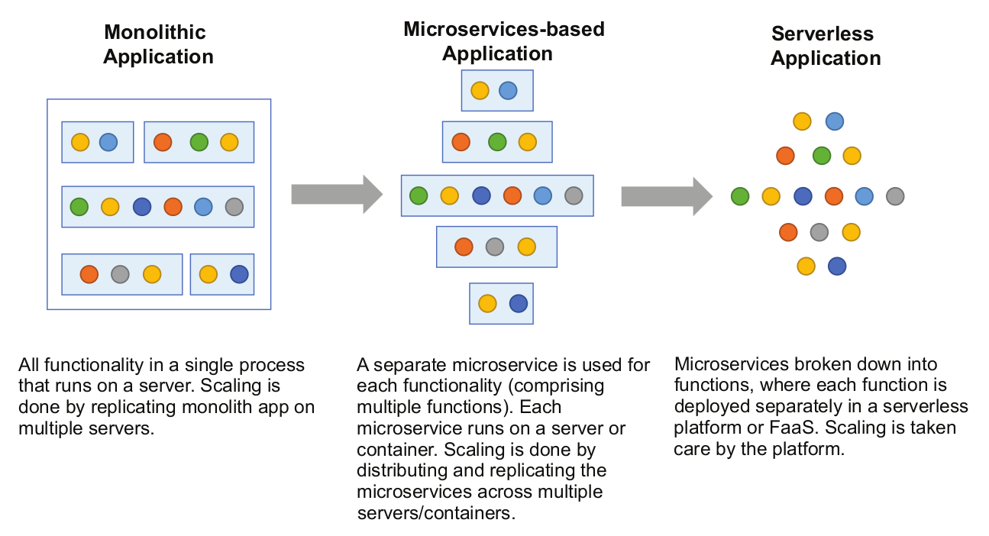
Monolith to Microservices to Serverless applications

Slide 10
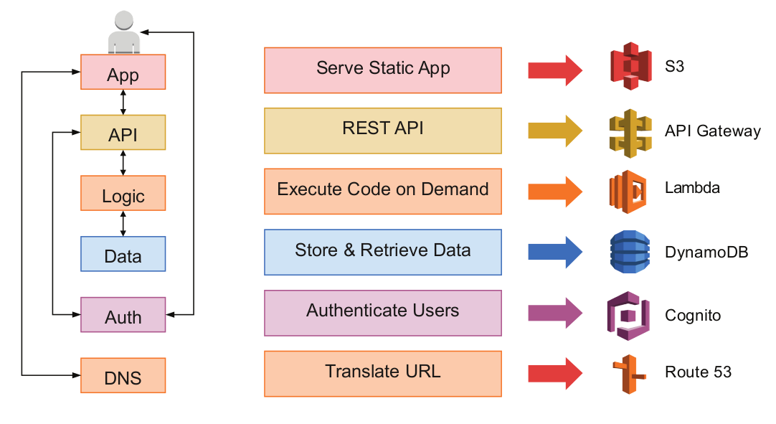
Cloud Services for Implementing Serverless Applications
Example of a multi-tier web application implemented with the serverless computing model.

Slide 11
Cloud Services for Implementing Serverless Applications
The web application compromises a static front-end implemented in HTML, CSS, and Javascript.
The static files for the front-end are deployed on Amazon S3 cloud storage

Slide 12
Cloud Services for Implementing Serverless Applications
The application front-end uses a REST API for interacting with backend.
The REST API is implemented using Amazon API Gateway

Slide 13
Cloud Services for Implementing Serverless Applications
The application logic is implemented using Lambda functions
The core functionality of the application is written as separate units of code (Lambda functions) that are executed in a serverless computing environment
Each Lambda function is responsible for specific aspects of the application logic
Lambda functions are small units of code that can be written in various programming languages (such as Python, Node.js, Java, etc.) and are executed in response to specific events, such as changes to data in an Amazon S3 bucket, updates to a DynamoDB table, or an HTTP request through Amazon API Gateway.

Slide 14
Cloud Services for Implementing Serverless Applications
For the database tier, the DynamoDB NoSQL database is used.
For user authentication, the Amazon Cognito service is used
Amazon Route 53 is used as the Domanin name service (DNS)

Slide 15
Pros and Cons of Serverless
Pros:
Low Operational Cost
Low Maintenance
Scalability
Availability & Fault Tolerance
Cons:
No control over the infrastructure
Time limits
Vendor lock-in
Not suitable for all use cases

Slide 16
Serverless Use Cases

Slide 17
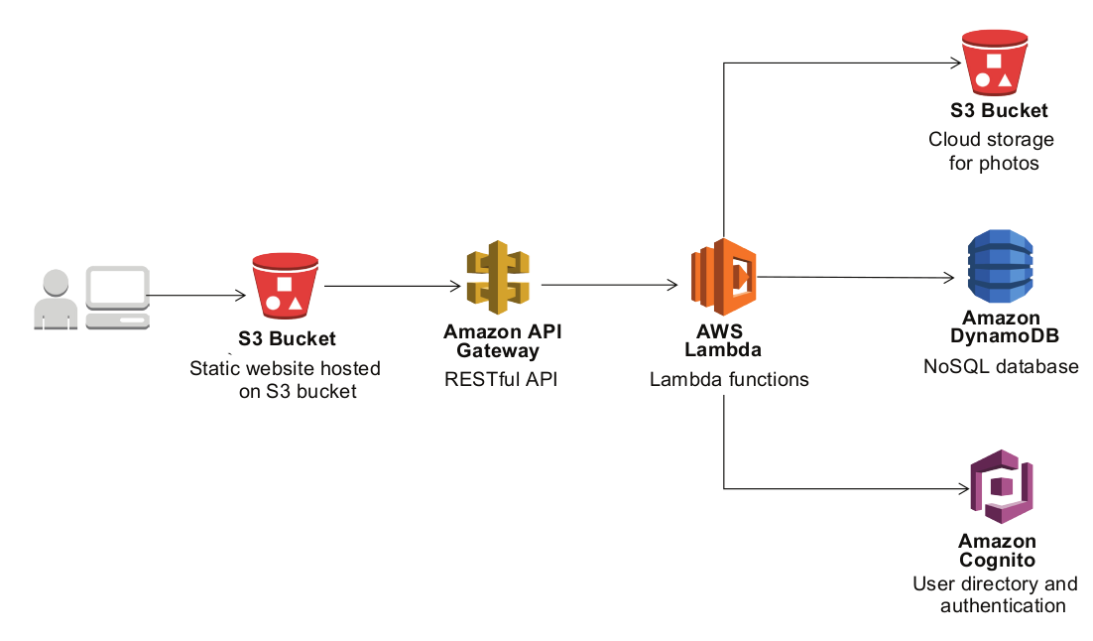
Serverless Use Case - Web Application
Using Lambda functions for web application backends

Slide 18
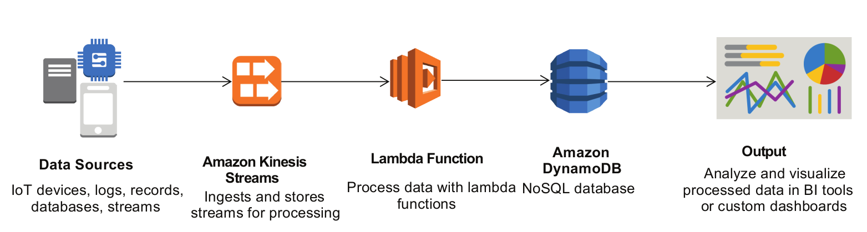
Serverless Use Case - Real-time Stream Processing
Using Lambda functions for real-time stream processing

Slide 19
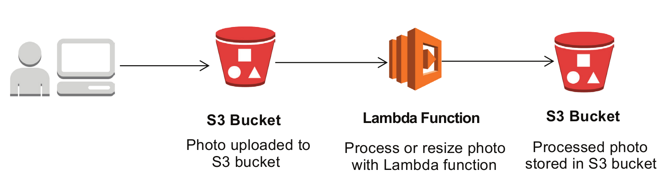
Serverless Use Case - Real-time File Processing
Using Lambda functions for real-time file processing

Slide 20
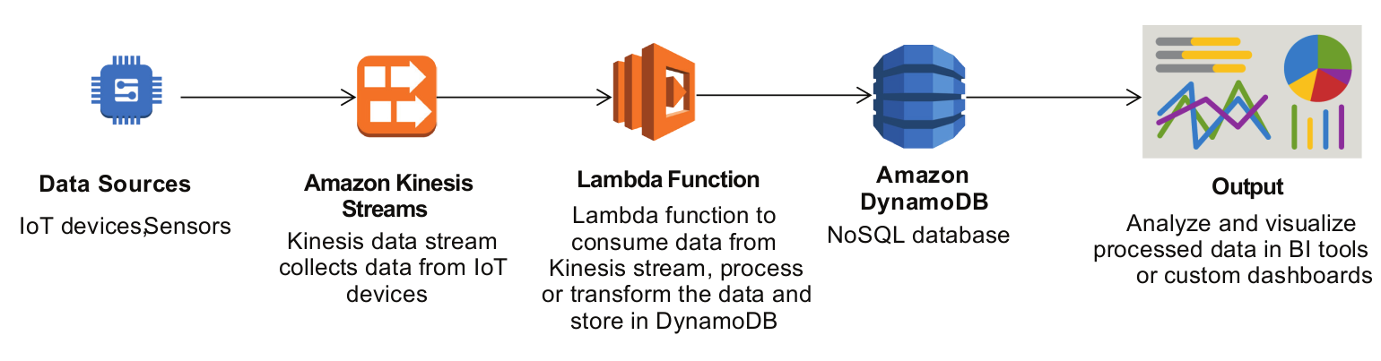
Serverless Use Case - IoT Backends
Using Lambda functions for IoT backends

Slide 21
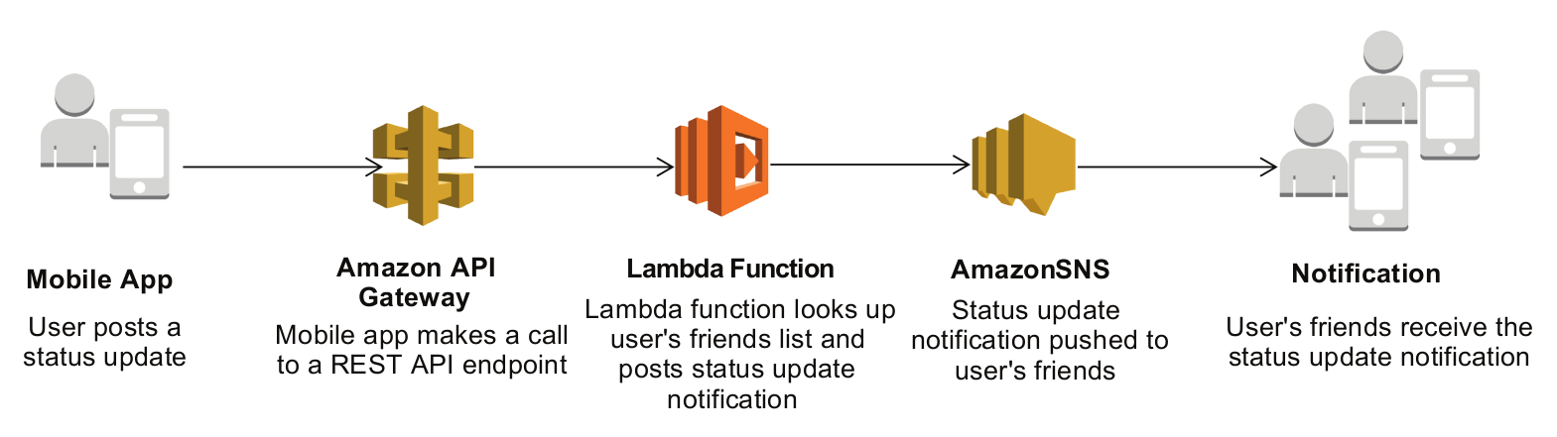
Serverless Use Case - Mobile Application Backends
Using Lambda functions for mobile application backends

Slide 22
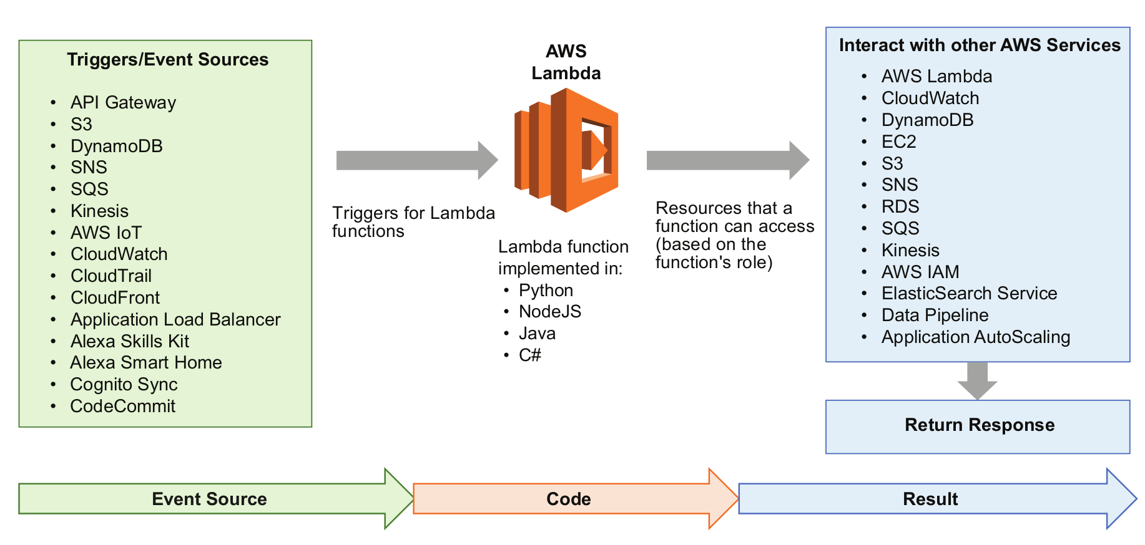
AWS Lambda
AWS Lambda is a serverless offering from Amazon Web Services (AWS). Lambda is a compute service that lets you run code without provisioning or managing servers.
Using Lambda, you can deploy your code as Lambda functions which are executed only when needed.
Lambda handles the provisioning and scaling of the compute infrastructure required to execute the functions.
The execution of Lambda functions is triggered in response to events.

Slide 23
Serverless Design Patterns
These serverless design patterns provide solutions to common challenges when building serverless applications. Each pattern is designed to address specific concerns, such as decoupling, scalability, and maintainability, and can be combined to create robust and flexible serverless architectures.
Asynchronous Processing with Messaging Queues
Load Balancing with Multiple Consumers
Priority Queues
Command Pattern
Fan-Out Pattern
Pipes and Filters

Slide 24
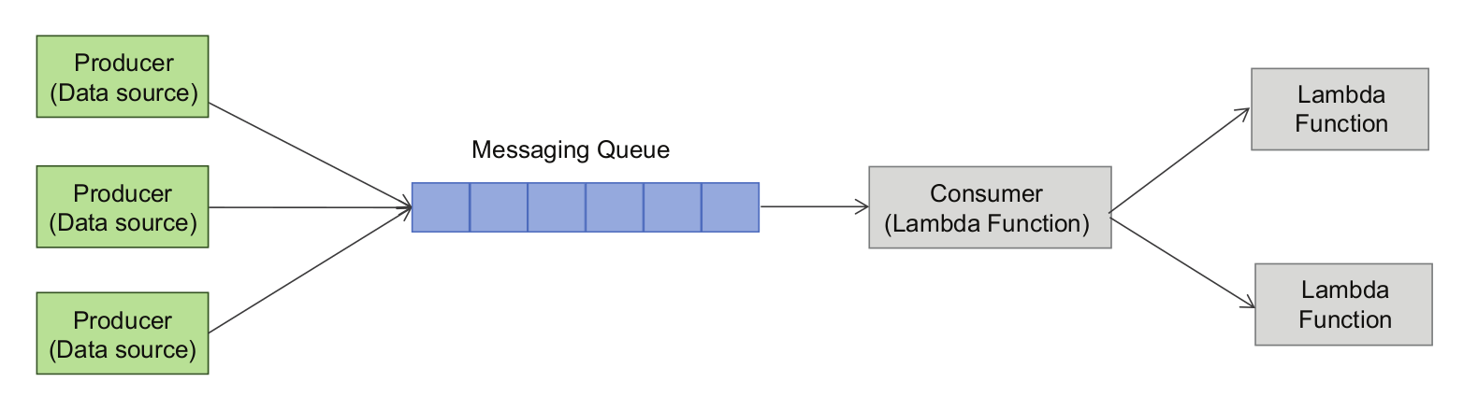
Asynchronous Processing with Messaging Queues
Objective: Decouple components by allowing them to communicate asynchronously through a messaging queue.
Implementation: Functions publish messages to a queue, and other functions subscribe to that queue for processing. This ensures that the producer and consumer functions are independent of each other's execution timelines.
Messaging queues can be used between the data producers and data consumers for asynchronous processing or load leveling.
Queues are useful for push-pull messaging where the producers push data to the queues, and the consumers pull the data from the queues.

Slide 25
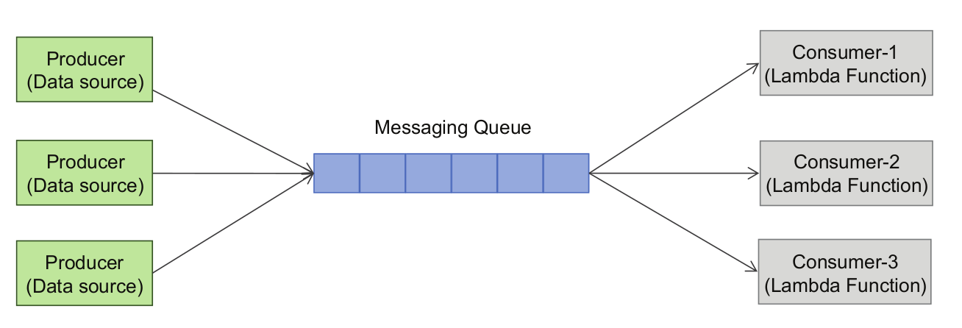
Load Balancing with Multiple Consumers
Objective: Distribute incoming workload among multiple function instances to improve performance and responsiveness.
Implementation: Use a load balancer to distribute events or requests to multiple instances of the same function. This pattern is especially useful for scenarios where a single function instance might struggle to handle the incoming workload efficiently.
While messaging queues can be used between data producer and consumer for load leveling, having multiple consumers can help in load balancing and making the system more scalable, reliable, and available.
Data producers push messages to the queue, and the consumers retrieve and process the messages.
Multiple consumers can make the system more robust as there is no single point of failure.
More consumers can be added on-demand if the workload is high.
Load balancing between consumers improves the system performance as multiple consumers can process messages in parallel.

Slide 26
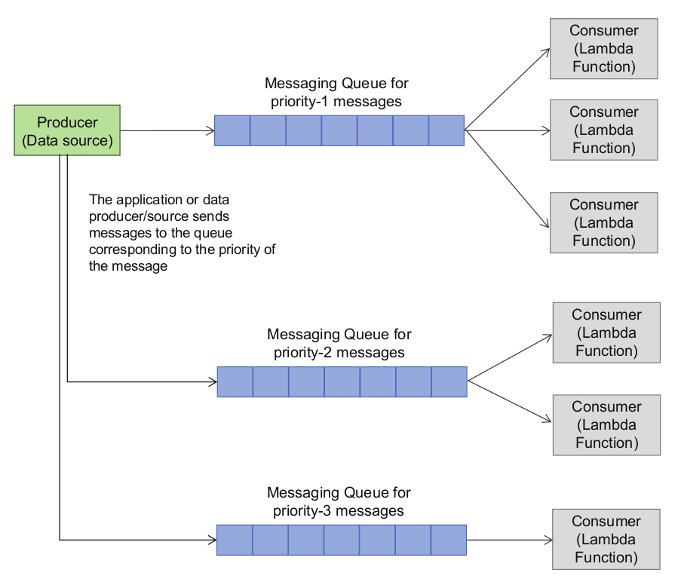
Priority Queues
Objective: Prioritize the processing of certain tasks over others based on their importance or urgency.
Implementation: Utilize a priority messaging queue where messages are assigned a priority level. Functions consuming from this queue can process higher-priority messages first, ensuring that critical tasks are handled promptly.
Priority Queue pattern is useful when you want to process messages with different priorities to be processed differently.
In a priority queue system, different queues are used for messages with different priorities, and each queue has different consumers.
Multiple consumers may be used for queues designated for high priority messages.

Slide 27
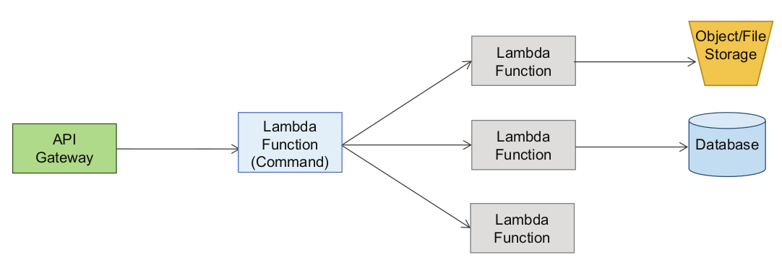
Command Pattern
Objective: Encapsulate a request as an object, allowing for parameterization, queuing, and the ability to support undo operations.
Implementation: Define commands as serverless functions and use a messaging or event-driven approach to invoke these commands. This pattern is useful for maintaining an audit trail, handling retries, and supporting undo or redo operations.
Command Pattern is useful when you want to decouple a sender or client who invokes a certain operation from a receiver or worker who performs the operation.

Slide 28
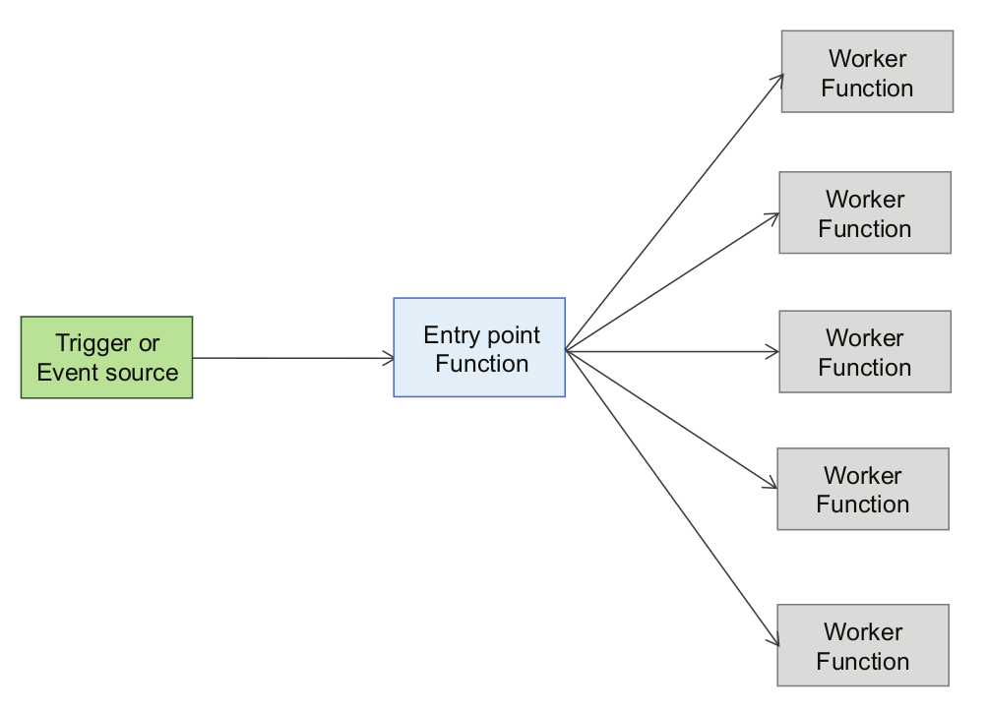
Fan-Out Pattern
Objective: Broadcast an event to multiple functions or services for parallel processing.
Implementation: When an event occurs, publish it to a topic or exchange, and multiple functions subscribe to that topic. Each subscribing function processes the event independently, enabling parallel and distributed processing.
The Fan-Out pattern is useful when you want to perform multiple actions or invoke multiple services or functions, while the event source supports only a single target.
In such a case, you can use a publish-subscribe messaging or a push notification system as the entry point, where the event source pushes a message to the entry point which invokes all the subscribed services or functions.

Slide 29
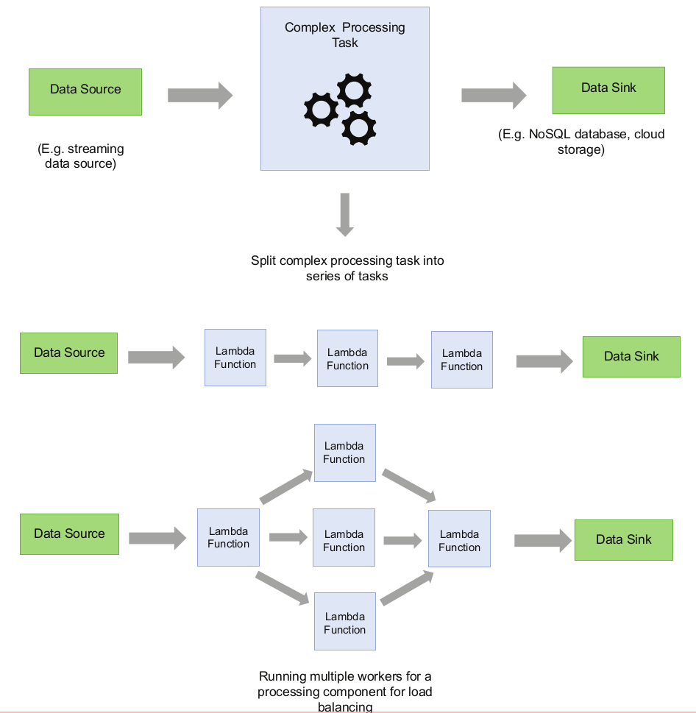
Pipes & Filters
Objective: Break down a complex task into a series of smaller, independent processing steps.
Implementation: Chain together multiple functions, each responsible for a specific processing step. The output of one function serves as the input to the next function in the pipeline. This pattern is useful for modularizing and reusing components.
In many big data applications, a complex data processing task can be split into a series of distinct tasks to improve the system performance, scalability, and reliability.
This pattern of splitting a complex task into a series of distinct tasks is called the Pipes and Filters pattern, where pipes are the connections between the ﬁlters (processing components).

Slide 30
Serverless concepts

Slide 31
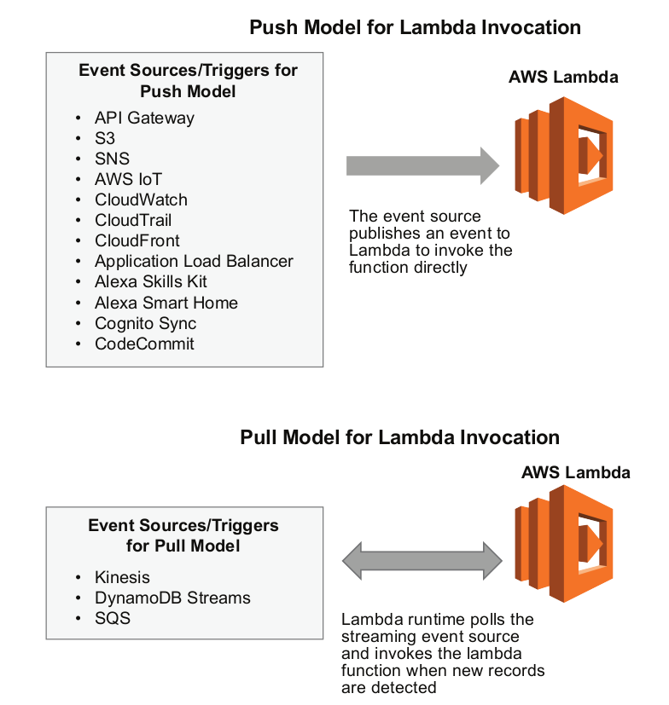
Push and Pull Models of Invocation
Lambda functions are invoked by event sources which can be an AWS service or a custom application that publishes events. The event-based invocation has two modes: push and pull.
In the push model, an AWS service (such as S3) publishes events which invoke the lambda functions.
The pull model works for poll-based sources (Kinesis, DynamoDB streams, and SQS queues). In the pull model AWS Lambda polls the source and then invokes the Lambda function when records are detected on that source.

Slide 32
Concurrent Execution
Concurrent execution refers to the number of executions of the functions which are happening at the same time.
Cloud providers set limits on concurrent executions.
In AWS Lambda, you can have at the most 1000 concurrent executions across all the functions in your account, which is the account concurrency limit.
You can also optionally set a function concurrency limit and reserve concurrency for a function out of the unreserved account concurrency limit.
For event sources that aren’t poll-based, you can use estimate the number of concurrent invocations of your Lambda functions using the formula: Events/Requests per second × Function Duration.
For poll-based event sources that are stream based (Kinesis or DynamoDB streams) the concurrency is equal to the number of active shards.
For poll-based event sources that are not stream based (SQS queues), each message batch can be considered a single concurrent unit.

Slide 33
Execution Duration
Cloud providers set a timeout limit under which a function execution must complete.
For example, AWS Lambda has a timeout limit of 5 minutes.
If the function takes a longer time to execute than the timeout limit, the function execution is terminated.
This makes the serverless computing model more suitable for real-time or short running operations rather than long-running batch operations.

Slide 34
Container Reuse
Cloud providers typically use containers for executing the functions in their serverless offerings.
A container helps in isolating the execution of a function from other functions.
When a function is invoked for the first time (or after a long time), a container is created, the execution environment is initialized, and the function code is loaded.
The container is reused for subsequent invocations of the same function that happen within a certain period.
However, as a developer, you should not assume that a container is reused.
The functions should be designed to be stateless, and any application state should be stored in external resources such as a database, cloud storage, or cache.

Slide 35
Cold and Warm Functions
When a function has not been executed for a long time or is being executed for the first time, a new container has to be created, and the execution environment has to be initialized. This is called a cold start.
Cold start can result in a higher latency as a new container has to be initialized.
The cloud provider may reuse the container for subsequent invocations of the same functions within a short period.
In this case, the function is said to be warm and takes much less time to execute than a cold start.
To reduce the execution time of functions and avoid cold starts, you can keep the functions warm by invoking them periodically.

Slide 36
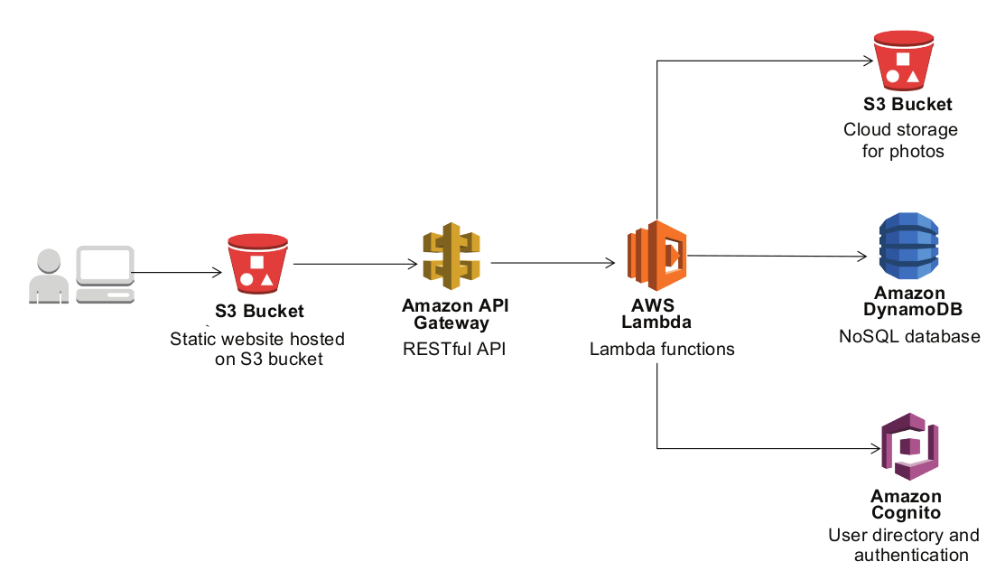
Case Study: Serverless Photo Gallery Application
The application has a static front end implemented in HTML, Javascript, and CSS.
The static files of the application are served through an S3 bucket enabled for static website hosting.
The application backend has a REST API implemented using Amazon API Gateway and Lambda functions.
Amazon Cognito is used for user authentication.
Photos uploaded to the application are stored in an Amazon S3 bucket.
The records of photos are maintained in a DynamoDB table.

